Slide 1




Respects The Globe, Respected Globally
Thermoforming Body Liner Counting Project Problems
Machine No#3
29th Oct 2021

Slide 2
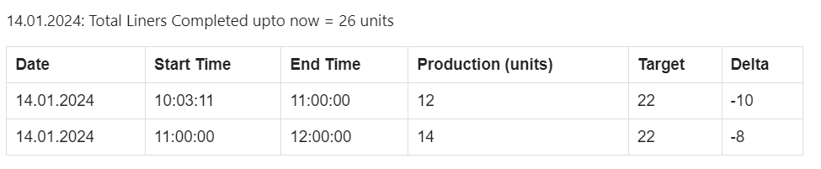



Problem 1: Counting Problem
Inaccurate Lower Body Count Reporting
The recorded lower body counts inaccurately reflect the actual numbers.
2. Ineffective Detection of Short Solenoid Valve Activations
The system exhibits limitations in accurately identifying all instances of brief solenoid valve activations.
3. Discrepancy in Production Quantity
Between 11 am and 12 pm, the recorded system count of produced units is 14, which contrasts with the actual production quantity of 22 units.
Low Body Liner Count
Missed solenoid activation detection
Actual ≠ Auto Count

Slide 3
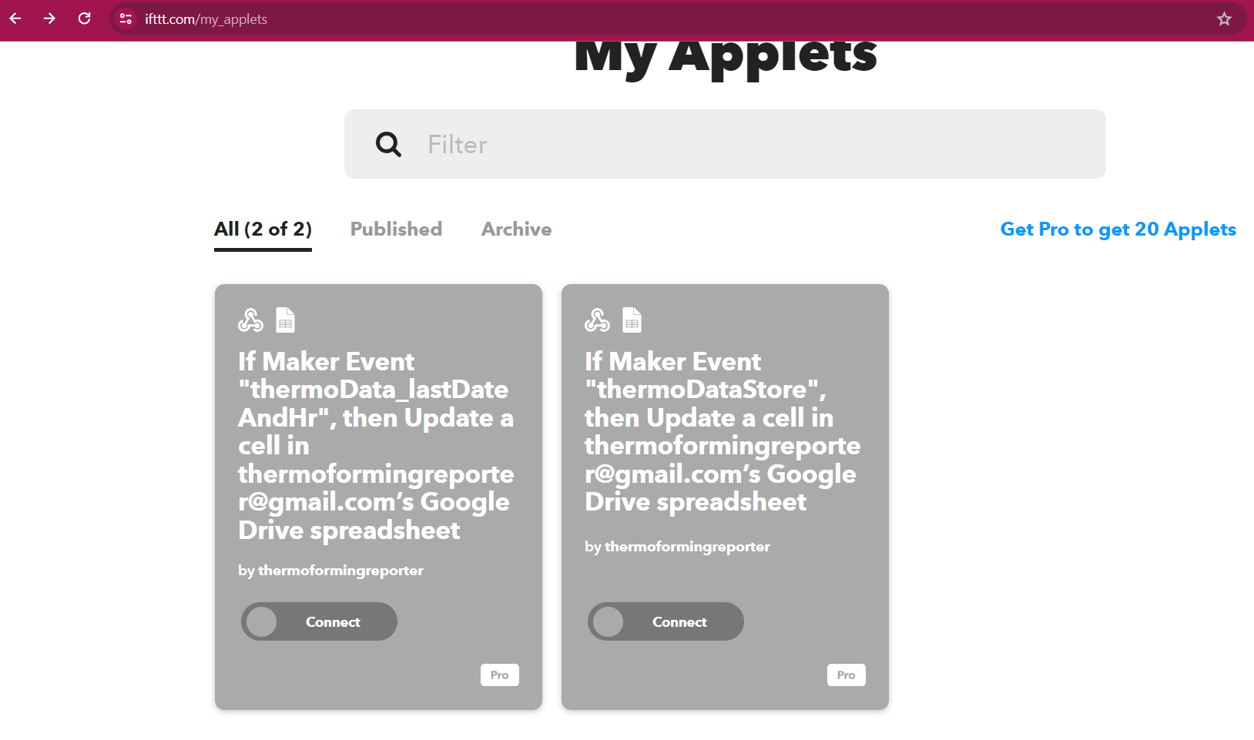
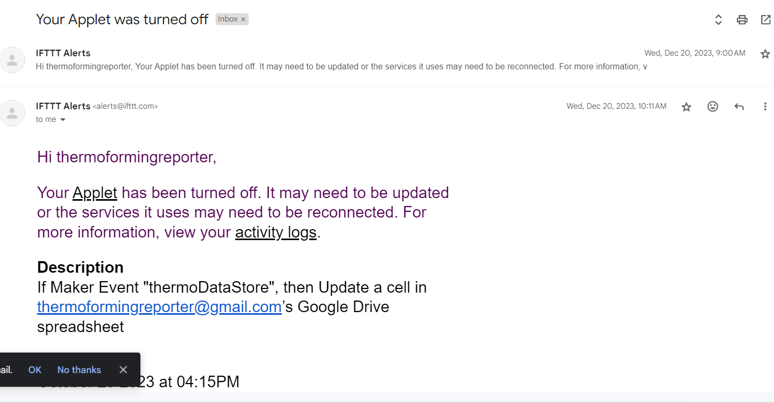
Problem 2: Data Logging Problem
3rd Party Service – IFTTT used to send data from the Microcontroller to Google Sheets has changed policy
The necessary services are now available in the subscription based category.

Slide 4
Probable Solutions to Problem 1

